Slide 1

MINI PROJECT 2022
Mobility aid device for wheelchair users to be used in a railway system
Guide:
Dr. R. Hari Krishnan, AP, SOME
Ambhareesh M D-123012008
Venkatraman S-123012046
Sethu Narayanan S-123012057

Slide 2
Table of content:
Motivation
Objective
Methodology /Work plan
Work done

Slide 3
Motivation:
There are a large number of mobility assistive devices such as manual and powered Wheelchair, modified electric scooters etc. to be used for locomotion in public places by Person with disabilities(PwD) and Elders.
But none of them are capable of entraining, detraining and traversing within the railway station and self transfer them to their designated seat.

Slide 4
Objective:
Our proposed project is to create a simulation of locomotion of mobility assistive device to be used in railway station.
For this, a step climbing Wheelchair is to be designed as a 3D model in SOLIDWORKS.
A closed loop control system for speed control of the locomotion is to be designed in MATLAB.
A closed loop control system for controlling the Linear actuator is to be designed
Finally, the 3D model should be integrated into CoppeliaSim software.

Slide 5
Methodology:
Mathematical modelling of PMDC motor
Design of Telescopic mechanism in SOLIDWORKS
Design of 3D model of step climbing wheelchair
Closed loop speed control system development for locomotion
Closed loop speed control system development for Linear actuator
Integrating 3D model in CoppeliaSim Software

Slide 6
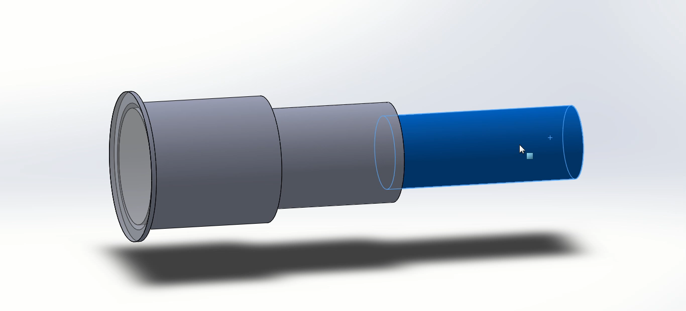
Design of Telescopic mechanism:

Slide 7
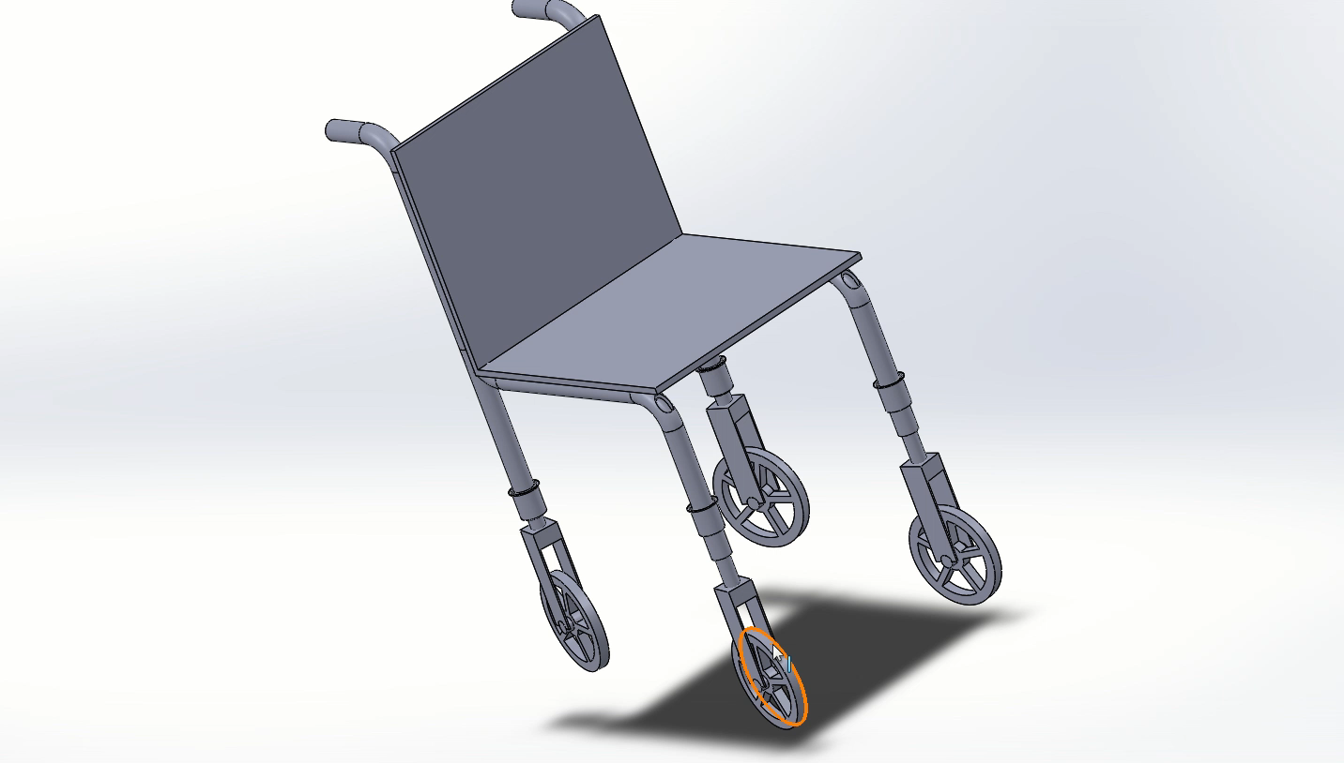
Design of Step climbing wheel chair:

Slide 8
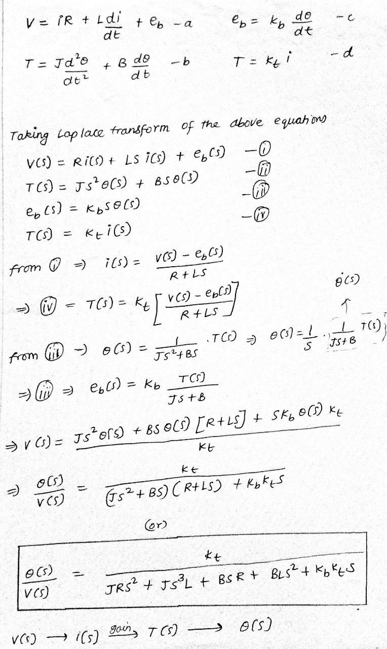
Mathematical modelling of PMDC motor

Slide 9
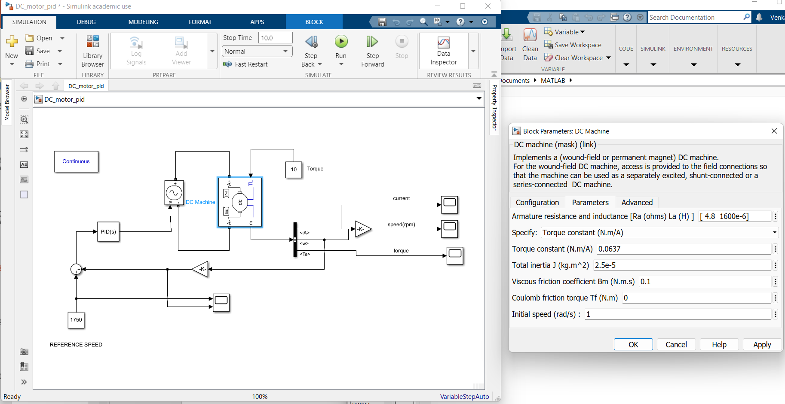
Closed Loop control System for locomotion

Slide 10
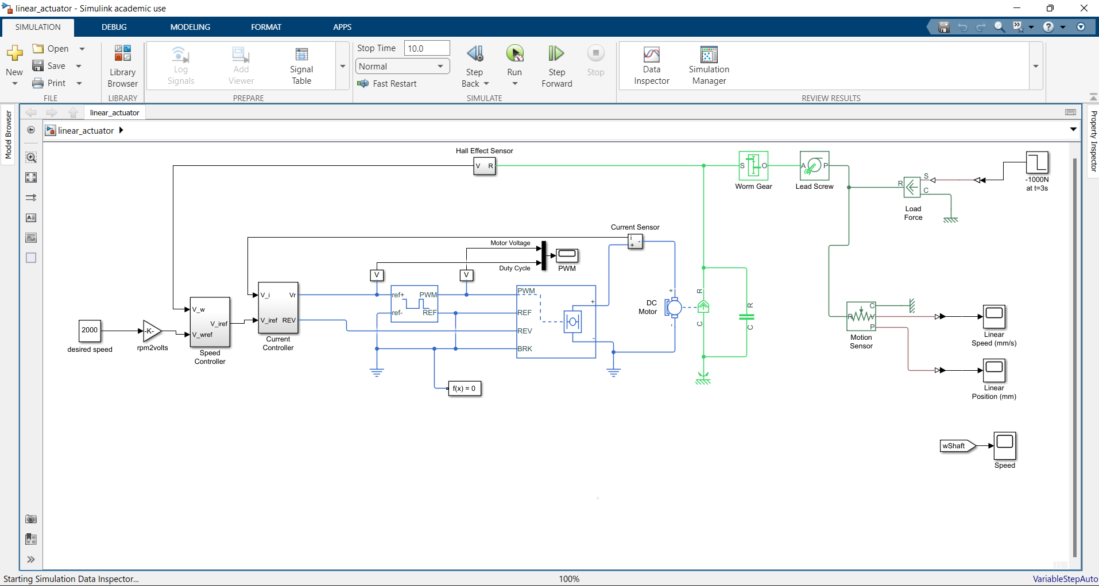
Closed Loop control System for Actuator

Slide 11
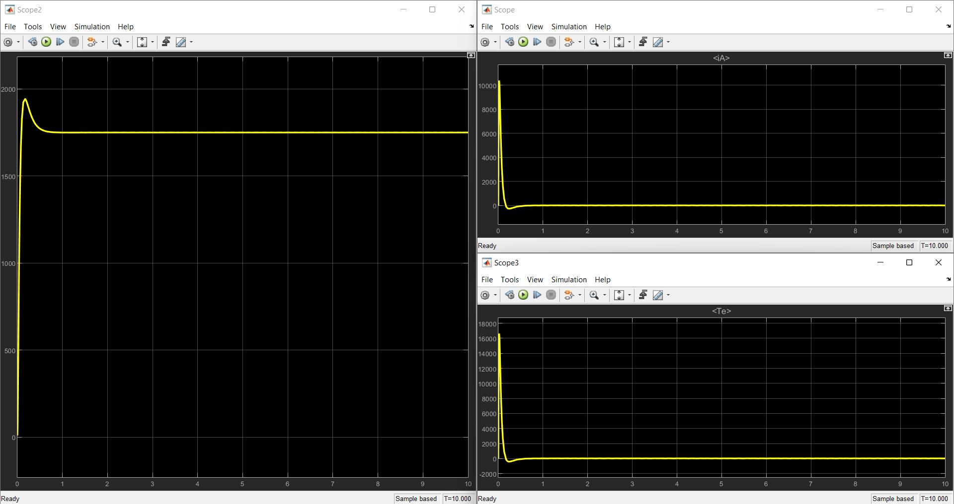
Result:
The Closed loop speed control system of PMDC Motor for locomotion yielded the desired response with rise time of 0.1s using the desired controller successfully.

Slide 12
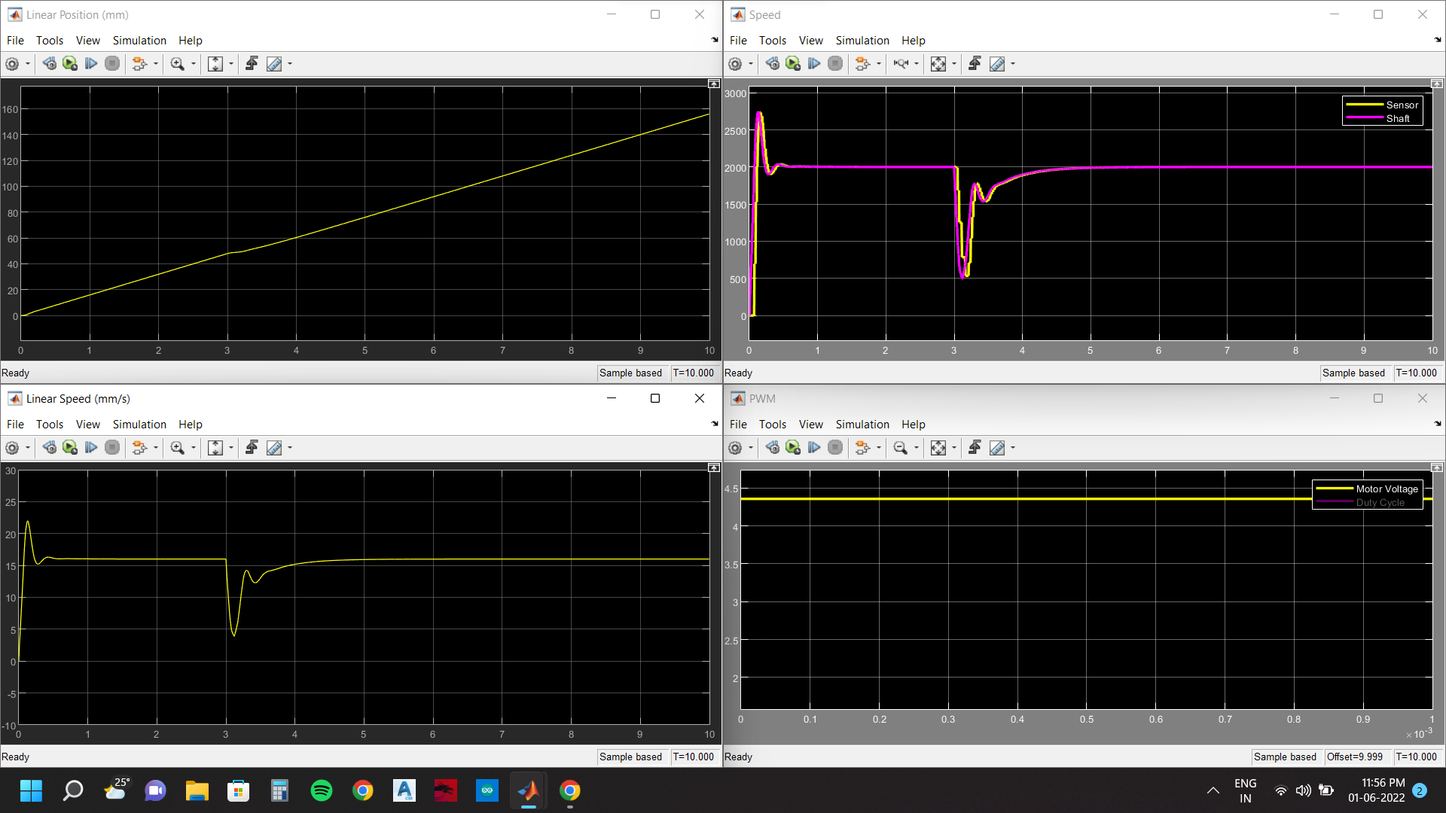
Result(cont.):
The Closed loop control system of PMDC Motor for locomotion yielded the desired response with rise time of 0.1s and settling time of 0.5s successfully.

Slide 13
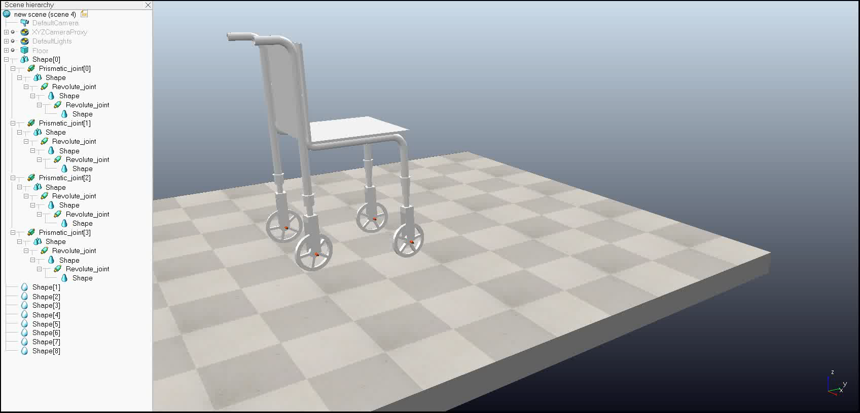
Discussion:
The SOLIDWORKS model that we created, when imported into CoppeliaSim software was unstable even though the Joint-Link Hierarchy and dynamics of links and joints was configured properly.

Slide 14
Thank you

